Slide 1


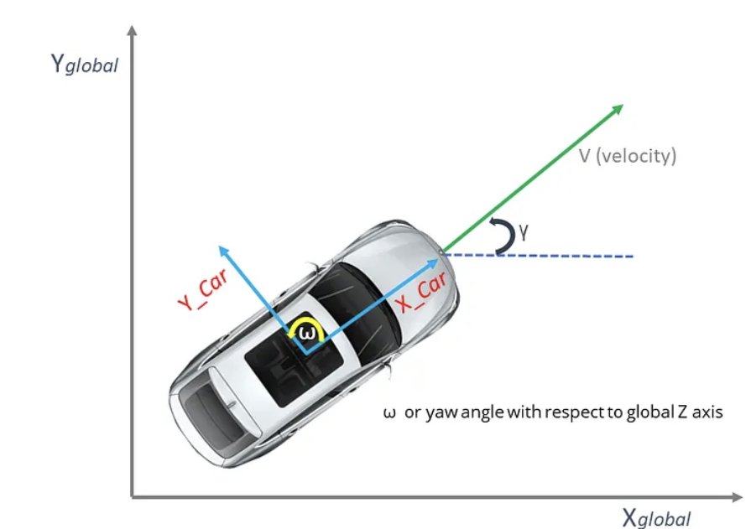
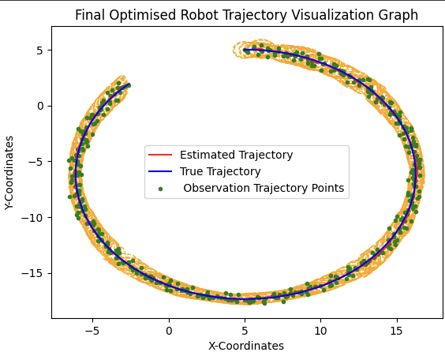
EKF Localization
By Mahir Kardame P2725883

Slide 2
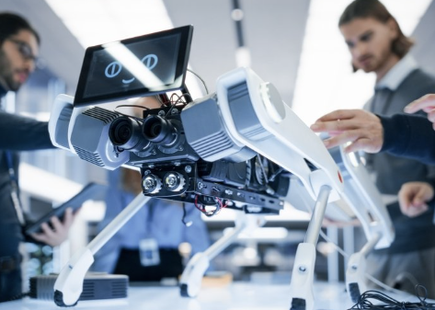

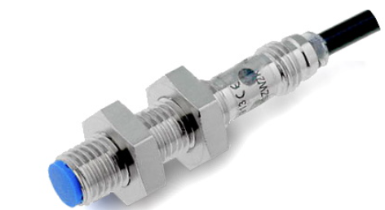
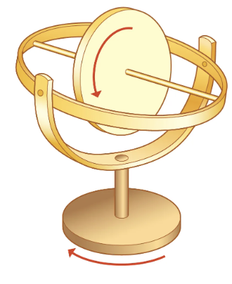
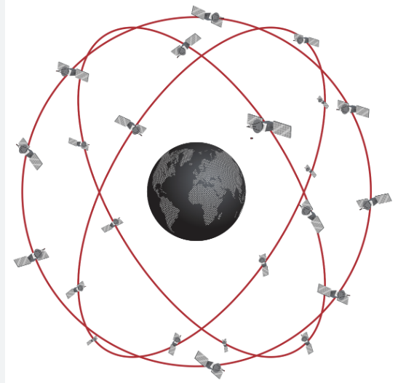
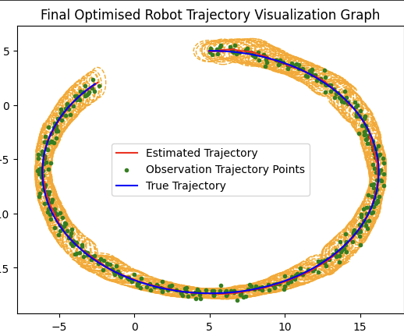
Overview Of The EKF Localization Project
Situation:
- Robot localization problem.
- Non-Linear System = Extended Kalman Filter (EKF).
- Google Colab using Python
Solution:
- Speed sensor: Robots Velocity.
- Gyroscope Sensor: Angular Velocity (Orientation).
- GNSS: Location in terms of x-y coordinates (smart GPS).
Findings:
- Parameter adjustment affects on localization.
- Visualization Graphs illustration on robot’s trajectory

Slide 3


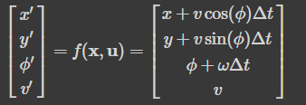

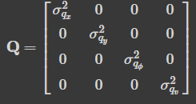

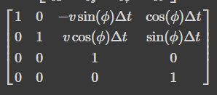
Process Model
Observation Model
Describes how the robots state evolves over time based on its motion (velocity & angular velocity).
Describes how the robot’s state corelates to sensor measurements, accounting for the noise (uncertainties) during the measurement process.
Consists of :
1- State Vector(xt) →
Crucial for Update Step.
Consists of :
2- Control Input Vector (ut) →
1- Observation Vector(zt) →
3 - Motion Function (f) :
2- Observation Function (h) →
3- Observation Noise (wz) & Covariance Matrix (R) :
4- Process Noise (wx) & Covariance Matrix (Q) :
4- Jacobian of Observation Function (Jh) →
5- Jacobian of Motion Function (Jf) :

Slide 4
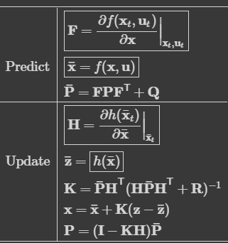







EKF Compact Formula
Update Step
Prediction Step
Corrects the predicted states using actual sensor measurements, adjusts the estimates based on how well it aligns with real world observations. This will help ensure a more accurate representation of the robot’s true state.
Algorithm forecasts the robot's future state based on its current state and the control input (u). Will provide an estimate of the robot's future state.
1- Kalman Gain : Determines the model’s prediction & actual sensor measurements.
1- State Prediction : Forecasts the future state of system based on current state.
2- State Update : Corrects the predicted robot state based on actual sensor measurements.
2- Covariance Prediction : Forecasts the uncertainty in the predicted state.
3- Covariance Update : Adjusts the uncertainty estimation of robot’s state via including prediction state & sensor measurements

Slide 5


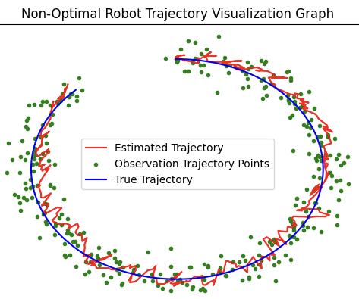
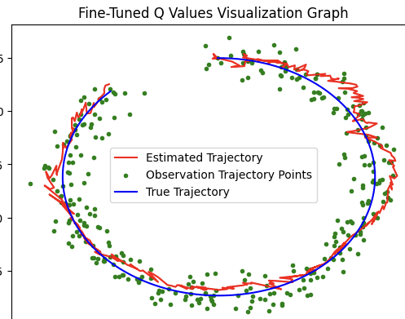
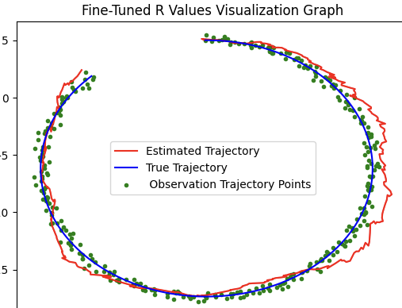
Parameter Fine-Tuning & Results 1
Process Noise Covariance (Q): Influences the level of uncertainty in the robot’s motion model.
Observation Noise Covariance (R): Determines the uncertainty associated with sensor measurements (speed, gyroscope & GNSS sensors).
- Reducing Q Values from 0.15 → 0.01
- Increasing both R Values from 1.5 –> 2.5
- Estimated Trajectory accuracy decreases
- Observation Trajectory accuracy significantly increases
- I chose Q Value = 0.20 for improved accuracy
- Robustness to noise in sensors improve

Slide 6


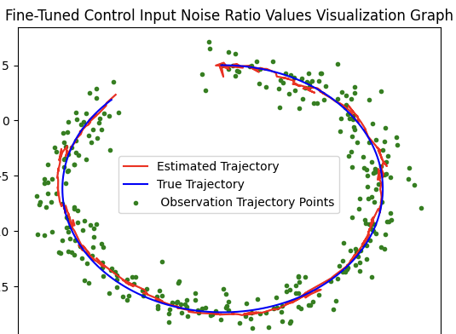
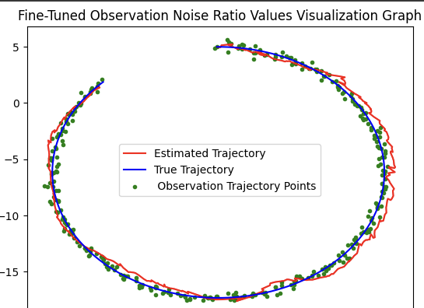
Parameter Fine-Tuning & Results 2
Observation Noise Ratio: Noise ratio, which is added to sensor measurements, which reflect the uncertainties & noise present in the GNSS sensor
Control Input Noise Ratio: Affects how predicted state will align with actual robot motion based on incoming sensor measurement data.
- Kept velocity value the same
- Reduced noise ratio values from 1.0 → 0.5
- Reduced angular velocity from 45 → 5 radians
- Obtained Excellent Observation Trajectory Points
- Estimated trajectory precision & accuracy improved
- Minimal spread of green dots

Slide 7

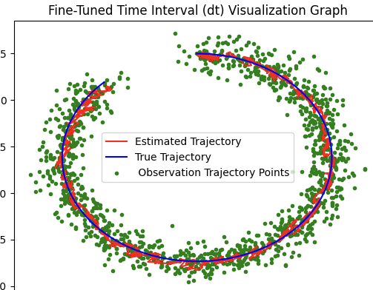
Parameter Fine-Tuning & Results 3
Time Interval (dt): Frequency of updates based on new sensor measurements
Changed dt values from 0.20 → 0.05
Significantly improved Estimated Trajectory accuracy.
However, increased computational load on EKF Algorithm (65 / 0.05 = 1,300)
Therefore, I chose 0.15 dt value to obtain improved accuracy and decreased computational burden on algorithm

Slide 8


Addressing Uncertainties in Covariance Matrix
Uncertainties arise in the robot’s estimated state.
Sensor noise/limitations, environmental conditions & imprecision in motion model (control input).
Gaussian zero mean white noise is implemented in motion model to account for uncertainties in the robot’s motion.
Mitigate Uncertainty effects by EKF adjust & update covariance matrix based on real-time incoming sensor measurements.
The Covariance Ellipse is the representation of uncertainty in robot’s estimated state.
Larger Ellipse = Higher Uncertainty Smaller Ellipse = Increased Confidence in the estimated state
Observations from Visualization Graph
Minimal spread of the covariance ellipse, demonstrating my model’s extremely high accuracy & precision when exposed to noise.
Covariance Ellipse is closely aligned with the true trajectory, indicating the EKF algorithm’s robustness to outliers & uncertainties.

Slide 9
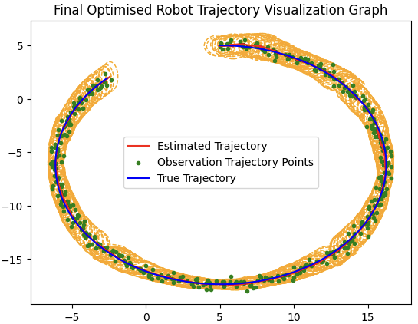
EKF Localization Performance & Analysis
Extremely high level of accuracy for the estimated trajectory, as shown by its immensely close alignment with the true trajectory.
Minimal Spread (Observation Points) = Exceptional Precision
Highlights the EKF’s robustness to uncertainty, both within the systems model & sensor measurements.
Demonstrates impressive robustness to noise, and truly remarkable levels of high accuracy & precision for estimation and observation trajectories.
Minimal spread of the covariance ellipse = High Accuracy
Close Alignment with the true trajectory, indicating the EKF algorithm’s robustness to outliers & uncertainties.

Slide 10
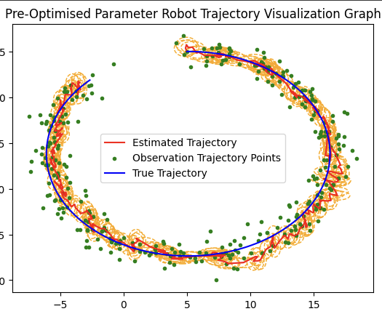
Final Conclusions
Impact fine-tuning parameters have on the EKF algorithm & its influences on estimated, observation trajectories & covariance matrix.
Excellent understanding of the EKF compact formula used, including the predicted & update steps.
Importance during robot's state prediction & correction.
Discovering the optimised parameters has yielded exceptional outcomes.
Recognized the importance of visualization graphs and how they help illustrate the trajectories of the robot localization problem.

Slide 11
References
https://atsushisakai.github.io/PythonRobotics/
https://matplotlib.org/3.1.1/api/_as_gen/matplotlib.patches.Ellipse.html
https://learningzone.dmu.ac.uk/content/enforced/79115-SM_61757964_2023_602/08_Robot_Localization_Part_3.pdf?ou=79115
https://stackoverflow.com/questions/67718828/how-can-i-plot-an-ellipse-from-eigenvalues-and-eigenvectors-in-python-matplotl
https://matplotlib.org/stable/gallery/statistics/confidence_ellipse.html
https://learningzone.dmu.ac.uk/content/enforced/79115-SM_61757964_2023_602/07_Robot_Localization_Part_2.pdf?ou=79115

